Slide 1
Higher Normal Forms
4NF, 5NF
Notes:
1
The slides for this text are organized into chapters. This lecture covers Chapter 19, on formal, dependency-driven database design..
Integrity constraints, in particular functional dependencies, play an important role in the design of database schemas. In particular, they can shed light on potential redundancies (and the problems that go with redundancy) in a relational schema. Typically, they are used to analyze the relational schema obtained by converting an ER diagram.
This chapter can be covered any time after the Foundations material (Chapters 1 to 5) is covered, at the instructor’s discretion. A good choice is to cover it after presenting all the implementation related material that is included in a course. This will allow a design sequence consisting of Chapters 19 and 20, and will enable the instructor to bring out the fact that design involves both redundancy analysis and performance considerations, and that these concerns should go hand-in-hand.

Slide 2
Dependencies
Functional Dependencies FDs: Role in decomposition and schema refinement
Multivalued Dependencies
Join Dependencies

Slide 3
4 NF
BCNF removes any anomalies due to FDs
Further research has led to the identification of another type of dependency called Multi-valued Dependency (MVD)
Proposed by R Fagin* in 1977
MVDs can also cause data redundancy
MVDs are a generalization of FDs
* R Fagin Multi-valued Dependencies & a new normal form for relational databases, ACM TODS2, No. 3 (Sept. 1977)

Slide 4
Multivalued Dependency
Relation R (Course,Teacher,textbook) CTX
Teacher T can teach course C and text X is recommended for this course
No FDs exist
Key is CTX
Recommended texts for a course are independent of instructor
CTX is in BCNF
There is redundancy:
Try inserting the fact that there is a new teacher for Physics101
The text optics is a text for Physics 101 course is recorded once per potential teacher

Slide 5
MVD
Consider the following relation CTX:
In relational databases, repeating groups are not allowed
Course | Teacher | Texts
DBMS | M Bhise NDJ | RG Korth
MDA | M Bhise | G Booch McRobb

Slide 6
MVD
1 NF Version
CTX
COURSE | TEACHER | TEXTS
DBMS | M Bhise | RG
DBMS | M Bhise | Korth
DBMS | NDJ | RG
DBMS | NDJ | Korth
MDA | M Bhise | G Booch
MDA | M Bhise | McRobb
NO FDs in this relation

Slide 7
Anomalies
New Teacher for DBMS
New Text for DBMS
Teacher teaching MDA leaves

Slide 8
Contd..
MVD: Texts for a course are independent of the instructors
CTX has no FDs at all (redundancies !!!)
Use 2 binary relationship sets : Instructor (C,T) and Text (C, X) as these 2 are independent relationships
If there is a tuple showing that C is taught by teacher T
And there is a tuple showing that C has a book X as text
Then there is tuple showing that C is taught by T and has text X
If tuples (c,t1,x1), (c,t2,x2) appear then (c,t1,x2) and (c,t2,x1) also appear

Slide 9
MVD
The relation CTX is not in 4NF as C->->T is a nontrivial MVD and C is not a key
But each of CT and CX are in BCNF
If a relation is in BCNF, and at least one of its keys consist of single attribute then it is also in 4NF

Slide 10
4 NF
Relation in BCNF and non-trivial MVDs absent

Slide 11
4 NF
Decompose CTX into CT & CX
CX
CT
COURSE | TEXT
DBMS | RG
DBMS | Korth
MDA | G Booch
MDA | McRobb
COURSE | TEACHER
DBMS | M Bhise
DBMS | NDJ
MDA | M Bhise

Slide 12
4 NF
Decompose CTX into CT and CX
Decomposition of CTX into CT & TX is not done on the basis of FDs (as there are no FDs)
Decompose CTX into CT & TX is done on the basis of MVDs
MVDs
Represents a dependency between attributes of a relation, such that for every value of A, there is a set of values of B & a set of values of C, The set of values for B & C are independent of each other
course →→ teacher (course multi-determines teacher)
course →→ text (text multi-dependent on course)

Slide 13
MVD
Decompose CTX into CT and CX
Phy taught by a new teacher
Nonlossy decomposition
CTX is in BCNF (all key )
CT and CX are also in BCNF (all key)
MVDs are generalization of FDs
Every FD is an MVD (but converse is not true)
CTX has 2 MVDs course->->teacher , course ->->Text (teacher multidependent on course)
Each course has well defined set of teachers and well defined set of texts

Slide 14
Contd..
MVD Definition : Let A,B,C be subsets of relation R, we can write A->->B if and only if, in every possible legal value of R, the set of B values matching a given (A value, C value) pair depends only on the A value and is independent of C value
Fagin theorem tells you that MVDs go in pairs
A->->B holds only if MVD A->->C also holds A->-> B| C
Every FD is an MVD in which the set of dependent (RHS) values matching a given determinant (LHS) value is always a singleton set

Slide 15
MVDs
Some MVDs are not FDs
The existence of such MVDs in CTX requires: to insert 2 tuples to add a new physics teacher
These 2 tuples are needed to maintain an integrity constraint that is presented by C->->X
CT and CX don’t include any such MVDs
A multi-valued dependency occurs when a determinant determines more than one dependent, and the dependents are independent of each other

Slide 16
Fagin Theorem
Stronger version of Heath’s Theorem
Let R{A,B,C} be a relation, where A,B,C are sets of attributes. Then R is equal to the join of its projections on {A,B} and {A,C} if and only if R satisfies the MVDs A->->B|C

Slide 17
4 NF
An MVDs A →→ B is trivial if
(a) B ⊆ A or
(b) A U B = R
A relation that is in BCNF & contains no non-trivial MVDs is said to be in 4NF
CTX is not in 4NF because course →→ teacher is a non trivial MVD
What about CT and CX?

Slide 18
MVD
R(C,T,X) has no FDs and is all key, hence in BCNF
Has redundancies
MVDs C->->T|X
R1 (C,T) R2 (C,X) have no FDs, in BCNF
No redundancies
C->->T and C->->X are trivial MVDs
Although T,X ⊆ C, C U T =R1 and C U X = R2

Slide 19
Multi-Valued Dependencies
Most common source of redundancy in BCNF schemas is to put 2 or more M:M relationships in a single relation

Slide 20
Fourth Normal Form 4NF
R is in 4NF if and only if, whenever there exist subsets A and B of attributes of R such that the nontrivial MVD A->->B is satisfied, then all attributes of R are also functionally dependent on A
The only nontrivial dependency (FDs or MVDs) in R are of the form K->X
R is in 4NF if it is in BCNF and all (nontrivial) MVDs in R are in fact FDs out of keys
CTX is not in 4NF since it involves MVD that is not an FD at all, let alone an FD out of a key
MVD A->->B is trivial if either A is a superset of B or the union of A and B is the entire R

Slide 21
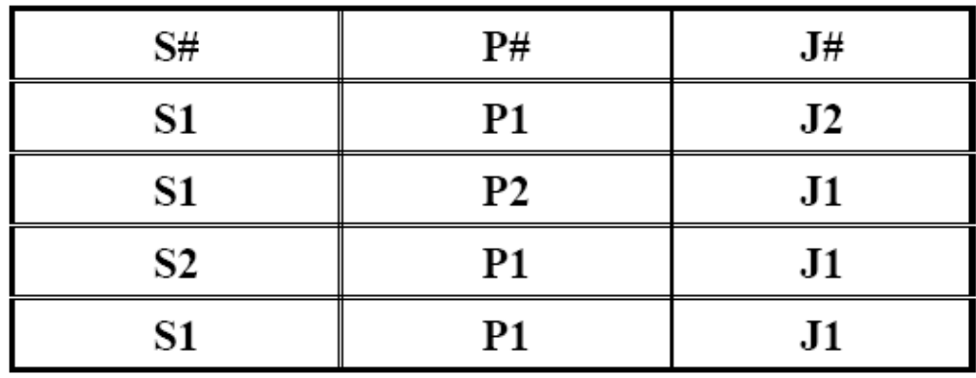
Suppliers-Parts-Projects Database SPJ

Slide 22
Join Dependencies
n- decomposable relation
(but not any m where m<n)
SPJ (supplier#, part#, project#) is the join of SP, PJ and JS
  If pair (s1,p1) appears in SP
  And pair (p1,j1) appears in PJ
  And the pair (j1,s1) appears in JS
  Then the triple (s1,p1,j1) appears in SPJ

Slide 23
Contd…
If s1 is linked to p1, p1 is linked to j1 and j1 is linked to s1, then s1,p1 and j1 coexist in the same tuple
A relation is n decomposable for some n>2 if and only if it satisfies some such n-way cyclic constraint
If (s2,p1,j1) is inserted then (s1,p1,j1) must also be inserted to validate JD integrity constraint

Slide 24
Join Dependency
JD is a constraint on the set of legal relations over a database schema. An instance of relation R is subject to a join dependency if it can always be recreated by joining multiple tables each having a subset of the attributes of R
If one of the tables in the join has all the attributes of the table T, the join dependency is called trivial

Slide 25
Join Dependency
Let R has subsets of attributes A,B,….Z then we say that R satisfies JD *{A,B,…,Z} if and only if every possible legal value of R is equal to the join of its projections on A,B,….Z
JD *{SP,PJ,JS}

Slide 26
Fagin’s Theorem (modified)
R{A,B,C} satisfies JD*{AB,AC} if and only if it satisfies the MVDs A->->B|C
MVD is a special case of JD (Like FD is a special case of MVD)

Slide 27
Nontrivial JD
JD* {A,B,….,Z} is trivial if and only if one of the projections A,B,…,Z is the identity projection of R (ie projection over all attributes of R)

Slide 28
JD and MVD
2-ary join dependencies are called multivalued dependency. More specifically if U is a set of attributes and R a relation over it, then R satisfies
  if R satisfies

Slide 29
5 NF
A->->B|C = *{AB,AC}
Most general form of dependency possible
SPJ involves a JD that is not an MVD (hence not FD either)
A relation is in 5NF (projection-join normal form PJ/NF) if and only if
  it is in 4 NF and
  every nontrivial join dependency that holds for R is implied by the candidate keys of R
SPJ can be decomposed into SP,PJ and JS and this is not implied by the fact that the combination (S#,p#,j#) is a candidate key
But SP,PJ,JS are in 5NF each

Slide 30
5 NF
Projection-Join NF (PJ/NF)
A relation is in 5NF if and only if every non-trivial join dependency in the relation is implied by the candidate keys.
A join dependency *{A, B, … Z} on R is implied by the candidate key(s) of R if each of A, B, …, Z is a superkey for R.[

